Slide 1
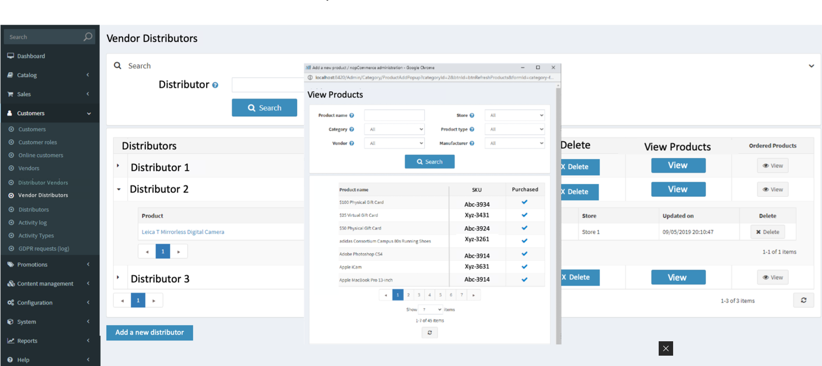
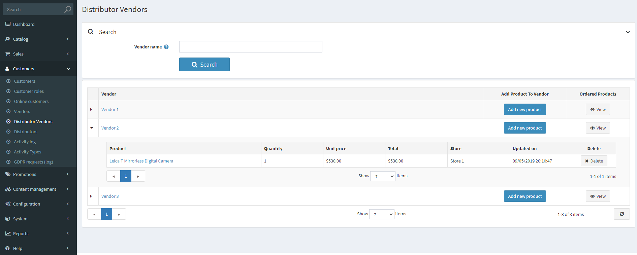
Vendor Details
Vendor Type
Store Name
Vendors Details
Vendor Name | Limited To Stores | Vendor Type | Online Status | Edit
Id | VendorId | IsLimitedToStore | LimitedToStores | VendorType

Slide 2
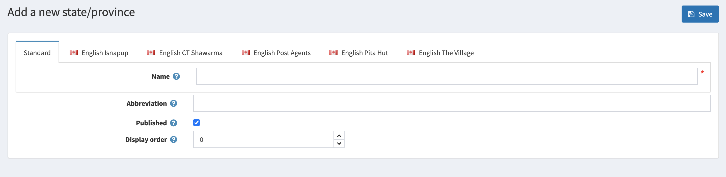

You can add new vendor type here by checking the box on the left hand side of the pop-up window and click save.
Vendor Types
Vendor Types
Vendor Types
Restaurant
Published
Details
Vendors
Edit
Add
Grocery Stores
Edit
Add
Pharmacy
Edit
Add
Add new Vendor Type
Add new Vendors
Vendor Distributors
Description
Add new Vendor Type

Slide 3
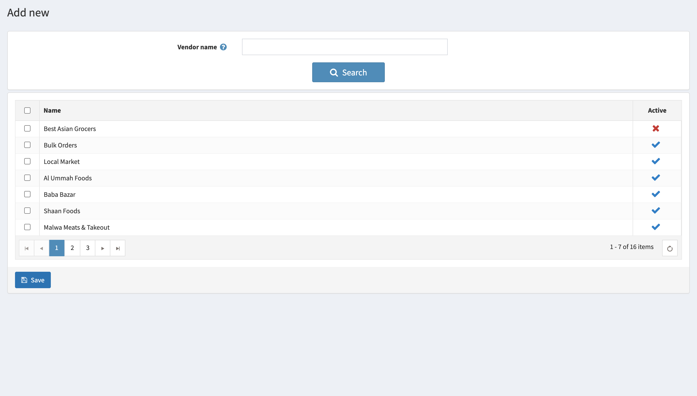
You can add new vendors here by checking the box on the left hand side of the pop-up window and click save.
Vendor Types
Vendor Types
Vendor Types
Restaurant
Published
Details
Vendors
Edit
Add
Grocery Stores
Edit
Add
Pharmacy
Edit
Add
Add new Vendor Type
Add new Vendors
Vendor Distributors
Description
Add new Vendor Type

